Slide 1
Same As EveR
Sanket Sudake

Slide 2
Bit About ME
Graduation
Web development in Python
Containers implementation in C for code execution
Started career as Linux Kernel Engineer(C)
Moved to Openstack, contribute to opensource project
In between
Kubernetes controllers(Go), Unikernels(Go), crypto exchange(Java)
Lead few projects - Lingk(UI, backend), Tinkerbell Baremetal OSS(Go, baremetal)
SRE world with Sunpower
CI/CD(Jenkins), SRE, Infra Automation(Terraform, Cloudformation)
Recent streaks
Fission, Nineops, NLG initiatives
Funnelstory - Backend, Databases, Integrations(Slack, Salesforce)
Notes:
Bit About Me
Slides just highlights few technologies and languages I have played across.
Programmed in languages - C, Python, Java, Go etc
Started from kernel stack, worked on frontend/backend, worked in openstack/kubernetes space as well.
Even though I had to explore different technologies, I try to find common theme across.

Slide 3

Recent Read
“Same As Ever” By Morgan Housel

Slide 4
CONSTANT TRENDS OVER PERIOD

Slide 5
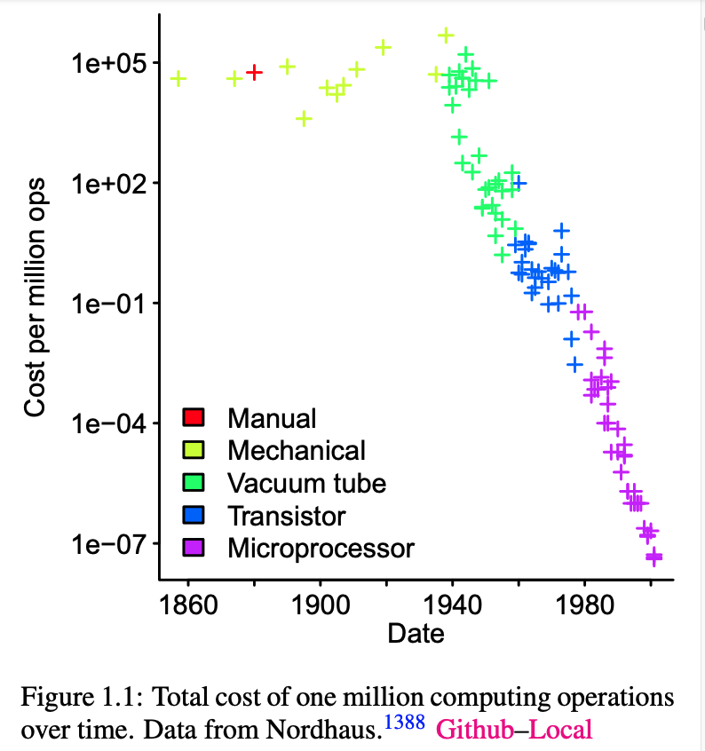
http://www.knosof.co.uk/ESEUR/ESEUR.pdf
Notes:
I have extracted few graphs from old book. These trends continue to thrive. Total cost of one million compute operations over time - We have been witnessing these as we see mobile phones get more compute power in the same cost

Slide 6
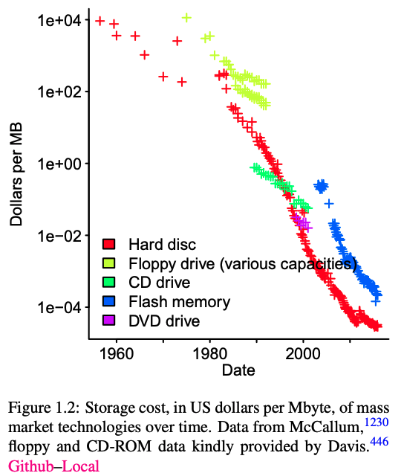
Notes:
Storage cost in per megabyte
General trend we see as consumer we are able to see storage costs are going down. Same stands in cloud.

Slide 7
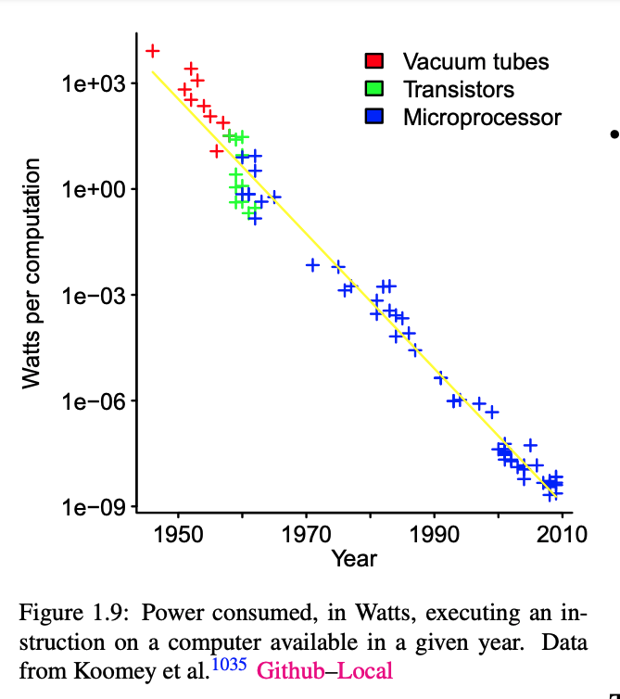
Notes:
Power Consumed in watts in executing instruction on a computer.
With recent advances in arm computing this has accelerated and we see focus more towards green computing.

Slide 8
LINDY EFFECT
The idea long something has existed, the longer it is likely to exist in future.
Eg. If book has been in print for 50 years, effect suggests it would in print another next 50 years.
If technology has been used for 20 years, it would be in use for another 20 years.
Infosys still uses cobol in mainframe business units. One of top performing revenue unit.
Notes:
Lindy effect
Lindy effect states that if something has existed for x years, it is more likely to exist in the future for x years

Slide 9
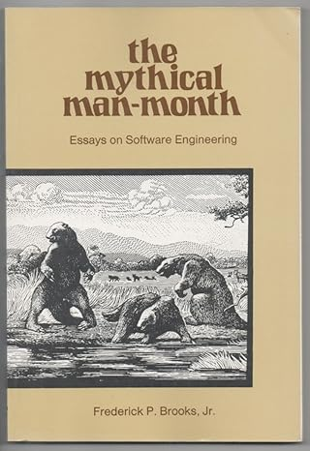
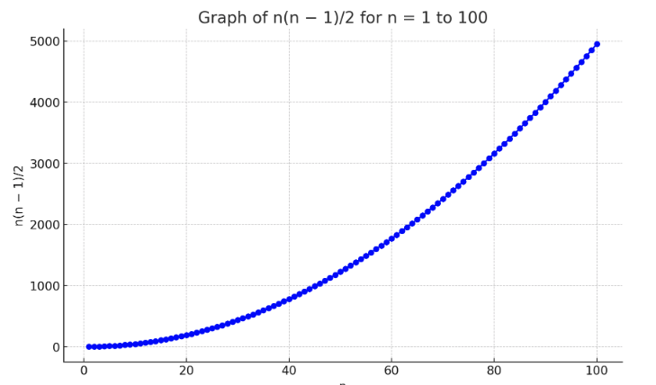
Published in 1974
Brooks Law - Adding manpower to late software makes it later
Group communication formula - n(n-1)/2
50 developers give 1224 channels of communication
Notes:
The Mythical Man-Month
The book was published in 1974 By Fred Brooks Turing award winner.
Many of thoughts expressed in book stand test of time.
Brooks' Law states that "adding manpower to a late software project makes it later." This is because the new workers require training and communication with the existing team, which consumes more time.
How do we get software deliverables late by 1 year?
One day at a time

Slide 10
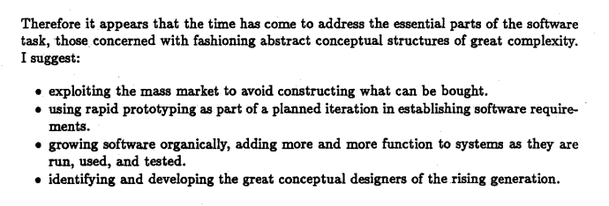
NO SILVER BULLET - BROOKS 1986
Notes:
Paper published in September 1986 https://www.cs.unc.edu/techreports/86-020.pdf
Paper states that there is no single development, in either technology or management technique, which can guarantee significant improvement in art of delivering software.
We have fundamentally 4 points mentioned the paper.
Leverage third party services, software rather than building everything on your own
Build POCs and iterate
Agile we talk of todays world. Build small and composable modules. Ensure its usable , testable etc.
Investing in people. Build processes/standards and keep moving from poor to good.
** Additional
No Silver Bullet: There is no single development, in either technology or management technique, which by itself promises even one order of magnitude (tenfold) improvement in productivity, in reliability, in simplicity.
Build One to Throw Away: You will anyway, so plan to. The idea is that system requirements will change during construction, so the first system built is barely usable, and it's best to plan for a rebuild.
Communication Overhead: As the team size increases, the number of communication channels increases exponentially, which significantly hampers the productivity.

Slide 11
My ThouGhT EXPERIMENTS

Slide 12
My Thought Experiment
Thoughts
We often focus on things which would change (3-5 years)?
What if we focus on things which would remain same(10 years) ?
Actions
I analyzed all tech projects I have worked on
Synthesize Constants than Variables
Notes:
We often focus on things which would be different from ten years from now ?
Rather if we focus on focus what would be same from 10 years from now ?

Slide 13
LearnING RATE
“Civilization can only progress only when it invents the method of invention, you can only progress when you learn the method of learning” -
Charlie Munger

Slide 14
Learning THE LEARNING
Learning something new is challenge
Phenomenon of learning always remains constant
Learning rate defines your productivity
You can always go vertical or horizontal
Target horizontal long term, vertical short term

Slide 15
FundaMENTALS are IMPORTANT
Everything is just abstraction on top of compute, storage, networking and memory
Software evolution is incremental, so the learning
Learn concepts/interfaces over implementations
You cannot understand x until you understand y
Virtualization - without how machine execute instructions
Containers - without how processes, networking and namespaces work
Kubernetes - without containers
Notes:
Fundamentals like linux basics, bash familiarity, understanding of containers
Why we need json, yaml , what is DSL
How DNS works?
Good to have understanding of
Operating systems
Database systems
Programming languages (1 interpreted, 1 low level, 1 functional) would serve you in long term

Slide 16
“A person with good learning rate and absolute CS fundamentals would be do better in long term over person with ready skill sets and lacking the earlier.”

Slide 17
Software WorlD - MEthoDS TO LEARN
Scanning docs and compress in mind for utilization
Ability to read unfamiliar code
Bash tools - Grep/Find/Ack
Ctags
Github code search
Copilot GPT
Ability to build/run new project and get it running
First two computers can assist you now :-)

Slide 18
TroubleSHOOTING & DEBUGGING
“The most effective way to debug a program is let someone else do it”
“Debugging is like being the detective in crime movie where you are also a murderder”- Filipe Fortes
Notes:
“The most effective way to debug a program is let someone else do it”
“Debugging is like being the detective in crime movie where you are also a murderder”- Filipe Fortes

Slide 19
Debugging And TRoubleShooting
Early in my career, solved lot of stack traces, kernel panics and escalations
Attention to details is key factor
When you are looking at crime scene you can’t miss important clues
Ability to logically dissect and address complex problems is vital

Slide 20
TroubleSHooting
Scan through data (logs, metrics, dashboards, dumps)
Relate problem to code
Build theories what could be going wrong and validate
Luckily you can reproduce behaviours in software
Repeat and reproduce until you solve

Slide 21
How do you Place yourself !
Category 1:
I am devops engineer excels in infra automation, CI/CD, monitoring, etc
Category 2:
I am devops engineer excels in infra automation, CI/CD, monitoring, etc with troubleshooting and production support experience.
We trust more in people from category 2(production experience).
Often people just want to deliver but don’t support(no skin in the game)
Being in production and being close to production makes your future code 5x better
You can’t be just in category 1 and make big stride in your career

Slide 22
Effective Collaboration and Communication

Slide 23
Collaboration & Communication
Software dev is not solo endeavor
Effective ways to communicate knowledge, ideas and progress are important
Knowing your role in a team and sticking to it
Empathy is key factor in communication

Slide 24
Activity
Reflect on your career
Identify which things are same backward and forward
Note them down in form
Identify your “same as ever”

Slide 25
Any FeedbacK ?

